Slide 1
Process

Slide 2
PROCESS
A process is an instance of a computer program that is being executed.
A program becomes a process when an executable file is loaded into memory.
Operating systems have many background tasks running, your computer is likely to have many more processes running than actual programs.

Slide 3
PROCESS (CONT.)
For example;
You may only have three programs running, but there may be twenty active processes.
You can view active processes in Windows by opening the Task Manager (press Ctrl-Alt-Delete and click Task Manager).

Slide 4
PASSIVE ENTITY & ACTIVE ENTITY
File containing list of instructions stored on disk (often called executable file) called passive entity.
A process is an active entity, with a program counter specifying the next instruction to execute and a set of resources.

Slide 5
A PROCESS GENERALLY INCLUDES
1. Process Stack
Process stack contain temporary data (such as function parameters, return addresses and local variables)
2. Data Section
Data section contains global variables.
3. Heap
Heap is a memory that is dynamically allocated during process run time.
4. Text Section
Contains program code.

Slide 6
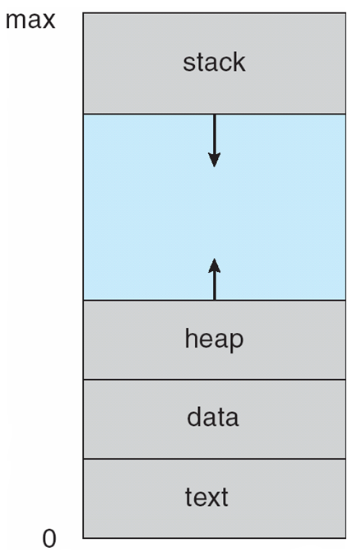
PROCESS IN MEMORY

Slide 7
PROCESS STATES
As a process executes, it changes state. Each process may be in one of the following states.
New
The process is being created.
Running
Instructions are being executed.
Waiting
The process is waiting for some event to occur( such as an I/O completion or reception of a signal).
Ready
The process is waiting to be assigned to a processor.
Terminated
The process has finished execution.

Slide 8

PROCESS STATES DIAGRAM

Slide 9
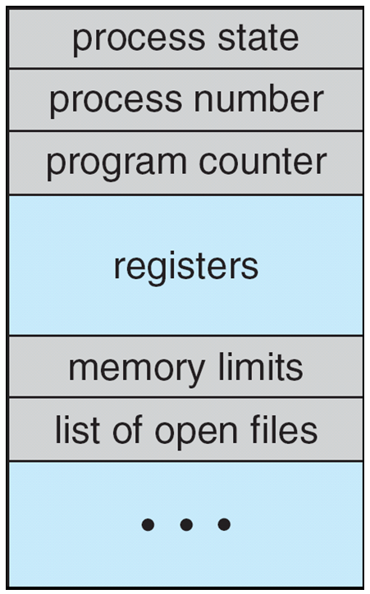
Process Control Block (PCB)
Each process is represented
in Operating System by a
Process Control Block(PCB).
It is also called a
task control block

Slide 10
Process Control Block (cont.)
Process state
The state may be new, ready, running,waiting and so on.
Program counter
Program counter indicate the address of the next instruction to be executed for this process.

Slide 11
Process Control Block (cont.)
CPU registers
The registers vary in number and type, depending on the computer architecture.They include:
Accumulators(i.e an accumulator is a register in which intermediate arithmetic and logic results are stored).
Index registers(i.e index register used for modifying operand addresses during the run of a program).
Stack pointers(The stack pointer is used to give the address of the stack area,where the local variables and parameters to subroutines are stored).
General purpose registers( i.e general purpose register is a small amount of storage available on the CPU whose contents can be accesses more quickly than storage available elsewhere).

Slide 12
Process Control Block (cont)
CPU-scheduling information
This information includes process priority, pointers to scheduling queues, and any ther scheduling parmeters.
Memory-management information
This include value of the base and limit registers, the page tables, or the segment tables.

Slide 13
Process Control Block (cont)
Accounting information
This information includes the amount of CPU and real time used, time limits, account numbers, job or process numbers and so on.
I/O status information
This includes the list of I/O devices allocated to the process, a list of open files and so on.

Slide 14

CPU Switch From Process to Process

Slide 15
Time Sharing
The objective of time sharing is to;
Switch the CPU among processes so frequently that users can interact with each program while it is running.

Slide 16
Process Scheduler & Process Identifier
Process Scheduler
The purpose of process scheduler is to selects an available process (possibly from a set of several processes) for program executing on the CPU.
Process Identifier (pid)
Process identifier is used to uniquely identify a process.

Slide 17
OPERATIONS ON PROCESSES
There are two main operations that are applied on process.
1. Process Creation
2. Process Termination

Slide 18
PROCESS CREATION
A process may create several new processes, via a create- process system call, during the course of execution.
Parent Process: The creating process is called parent process.
Child process: The new process is called the children of that process.

Slide 19
PROCESS CREATION (cont.)
Each of these new process may inturn create other processes, which forming a tree of processes.

Slide 20
PROCESS TERMINATION
A process terminate when it finishes executing its final statement and ask the operating system to delete it by using the exit() system call.

Slide 21
THREE MAJOR ACTIVITIES OF AN OPERATING SYSTEM IN REGARD TO MEMORY MANAGEMENT
Operating System has following three major activities in regard to memory management.
Keep track of which part of memory are currently being used and by whom.
Decides which processes are to be loaded into memory when memory space becomes available.
Allocate and de-allocate memory space as needed.

Slide 22
THREE MAJOR ACTIVITIES OF AN OPERATING SYSTEM IN REGARD TO SECONDARY STORAGE MANAGEMENT
Operating System has following three major activities in regard to secondary storage management
Free space management
Storage management
Disk Scheduling

Slide 23
SCHEDULING QUEUES
As processes enter the system, they are put into a job queue, which consists of all processes in the system.
Ready Queue
The processes that are residing in main memory and are ready and waiting to execute are kept on a list called the ready queue.
Device Queue
Suppose the process makes an I/O request to a shared device , such as printer. Since there are many processes in the system, the printer may be busy with the input/output request of some other process. The process may have to wait for the printer. This list of processes waiting for a particular I/O device is called device queue.

Slide 24
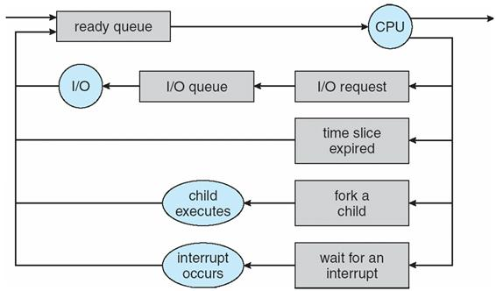
SCHEDULING QUEUES(CONT.)

Slide 25
WHICH EVENTS COULD OCCUR WHEN A PROCESS IS ALLOCATED THE CPU AND IS EXECUTING
When a process is executing , then following events can occurs.
The process could issue an I/O request and then be placed in an I/O queue.
The process could create a new sub-process and wait for the sub-process’s termination.
The process could be removed by force from the CPU, as a result of an interrupt, and be put back in the ready queue.

Slide 26
SCHEDULERS
There are three types of schedulers in Operating System
Long Term Scheduler (or job scheduler)
selects which processes should be brought into the ready queue. New state to ready state.
Short Term Scheduler (or CPU Scheduler)
selects which process should be executed next and allocates CPU. Ready state to running state.
Medium Term Scheduler (or swapper)
responsible for suspending and resuming the processes. Main memory to Secondary memory.

Slide 27
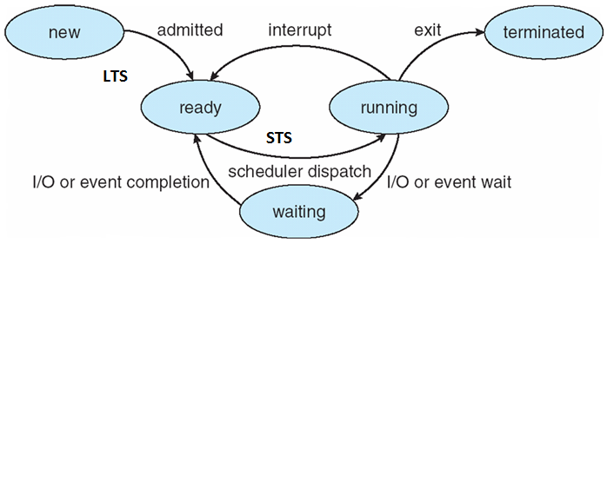
Process State Diagram

Slide 28
Degree of Multiprogramming
The no. of processes present in the main memory at any point of time is called degree of multiprogramming.
Long Term Scheduler controls the degree of multiprogramming.
LTS should select the good combination of CPU bound and I/O bound Process in order to get good throughput.
If more CPU bound Process then CPU utilization more and throughput low.

Slide 29
I/O-bound process
Spends more time doing I/O than computations, short CPU bursts
CPU-bound process
Spends more time doing computations; very long CPU bursts
CPU Burst
a time period during which the process wants to continuously run in CPU.

Slide 30
Cooperating Processes
Processes within a system may be independent or cooperating
Independent process cannot affect (or be affected) by the execution of another process
Cooperating process can affect (or be affected) by the execution of another process
Advantages of process cooperation
Information sharing
Computation speed-up
Modularity (application will divided into modules/sub tasks)
Convenience (may be better to work with multiple processes)

Slide 31
Inter Process Communication(IPC) Mechanisms
Cooperating process require a facility/mechanism for interprocess communication(IPC)
There are two basic mechanism provided by most systems
1. Shared Memory
2. Message Passing

Slide 32
Shared Memory IPC Mechanism
A region of shared memory is established between (among) two or more processes
Establisment of that shared region is done via the help of the operating system kernel
Then, processes can read and write shared memory region (segment) directly as ordinary memory access (like they are accessing memory variables directly without kernel help)

Slide 33
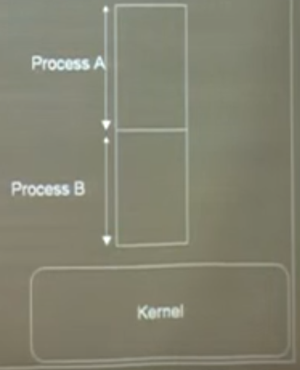
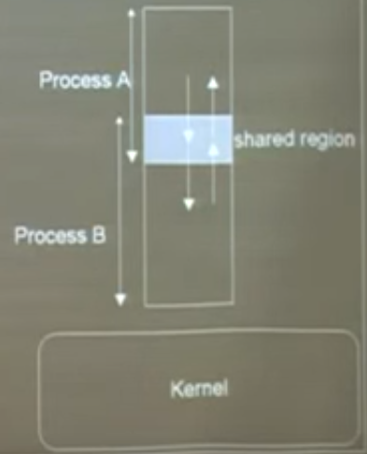
Shared Memory IPC Mechanism

Slide 34
Shared Memory IPC Mechanism
To illustrate the use of the shared memory IPC mechanism, a general model problem, called producer-consumer problem, can be used.
Producer-consumer problem
we have a producer, a consumer and data is sent from producer to consumer.
unbounded-buffer places no practical limits on the size of the buffer
Bounded-buffer assumes that there is fixed buffer size

Slide 35
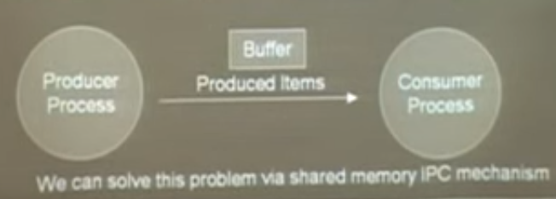
Producer-Consumer Problem

Slide 36
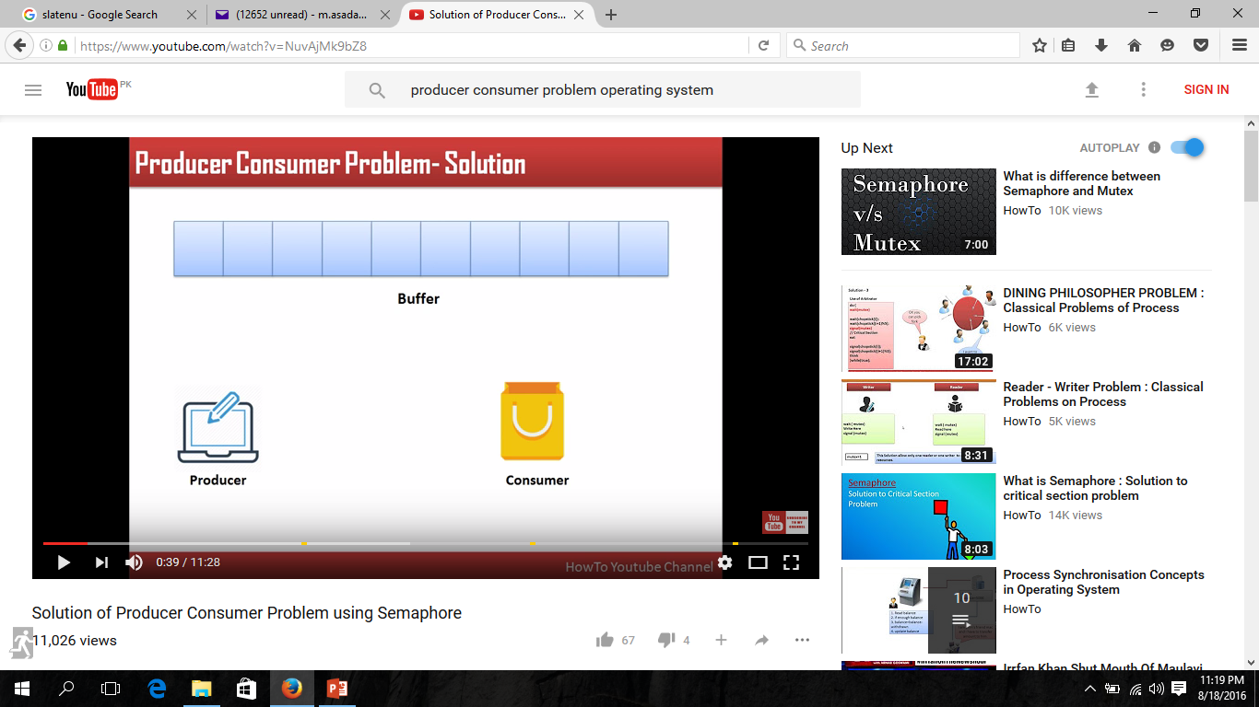
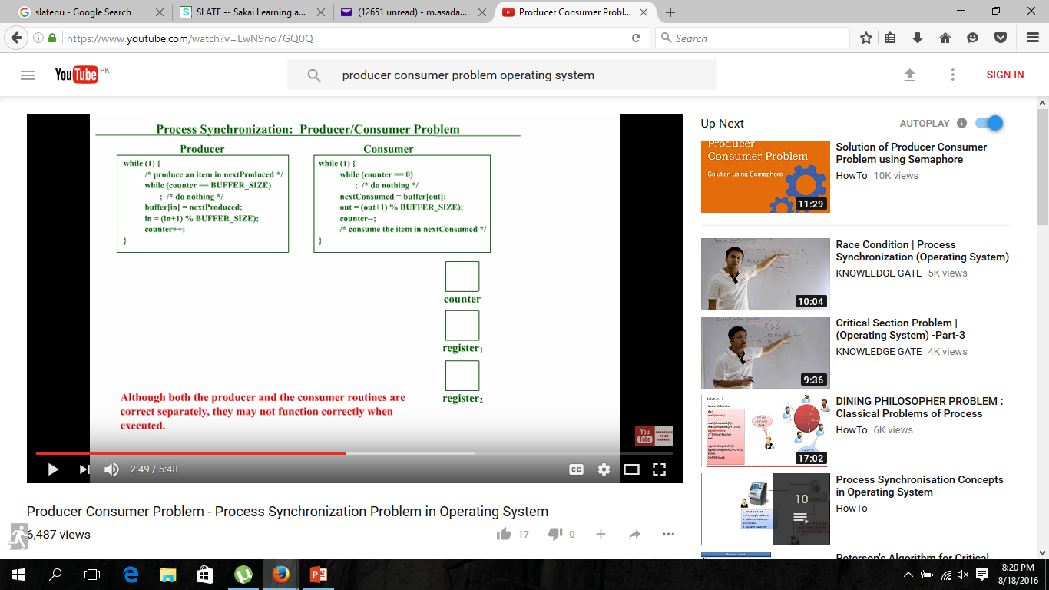
Producer-Consumer Problem

Slide 37
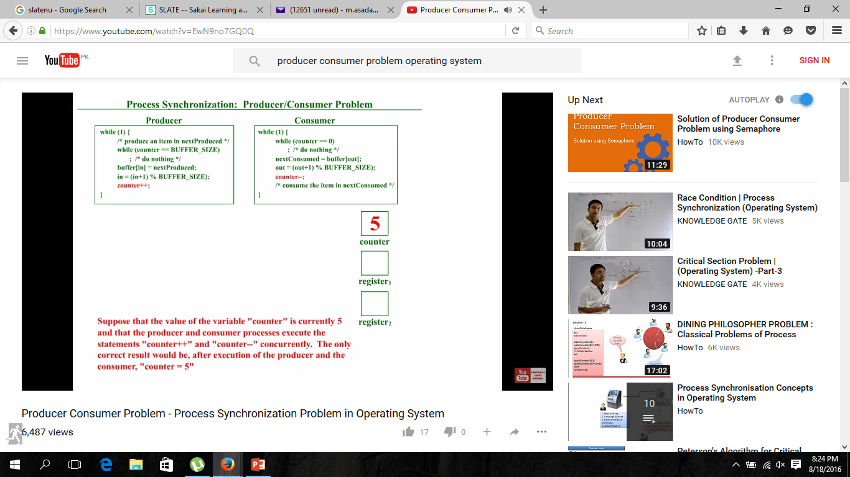
Producer-Consumer Problem

Slide 38
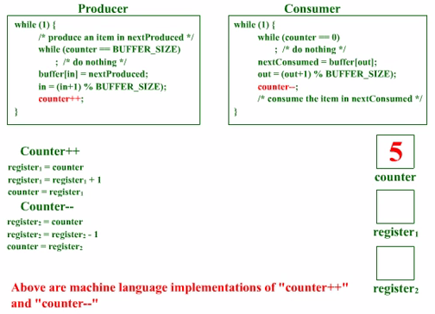
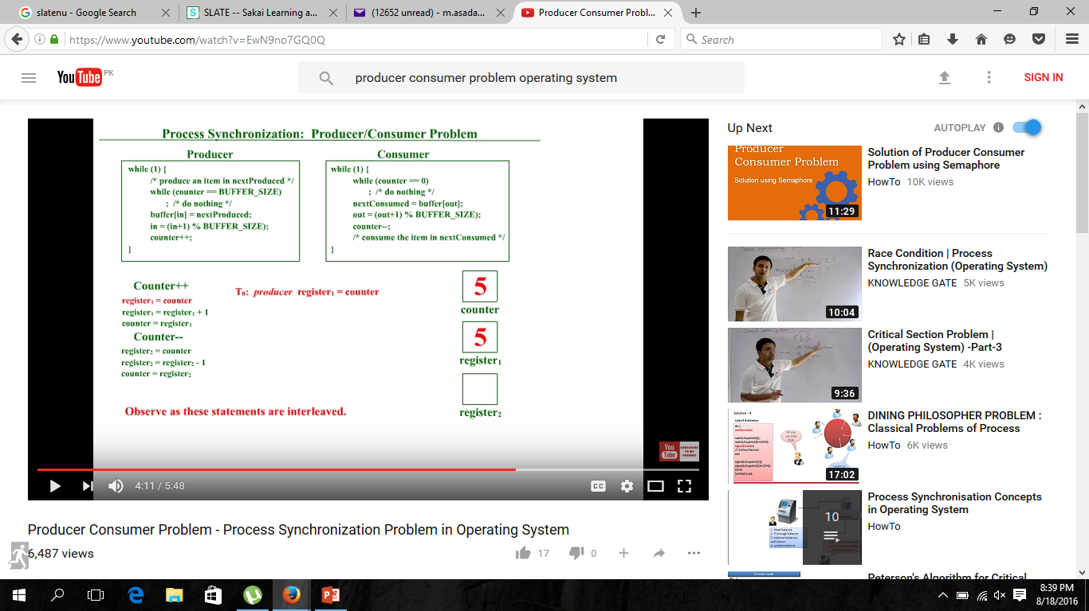



Slide 39
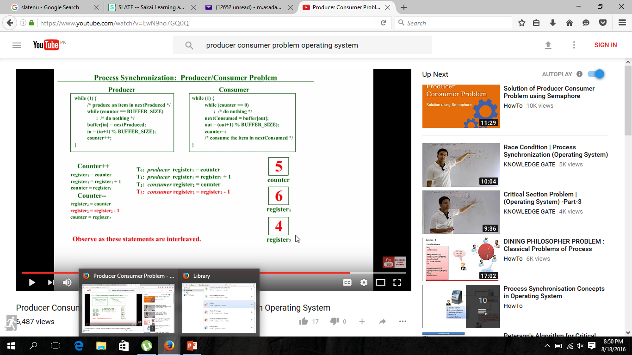



Slide 40
Message Passing IPC Mechanism
Mechanism for processes to communicate and synchronize their actions
This IPC facility provides two operations:
Send (message)- message size fixed or variable
Receive (message)
If P and Q wish to communicate, they need to:
establish a (logical ) communication link between them.
Exchange messages via send/receive

Slide 41

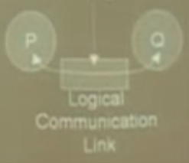
Message Passing IPC Mechanism

Slide 42
Direct Communication
Each process wanting to communicate must explicitly name the recipient or sender of communication.
send (destinatination-process P, message) – send a message to process P
receive(source-process Q, message) – receive a message from process Q
Properties of a direct communication link
Links are established automatically
Link is associated with exactly one pair of communicating processes
Between each pair there exists exactly one link
The link may be unidirectional, but is usually bi-directional

Slide 43
Indirect Communication
Messages are directed and received from mailboxes
Each mailbox has a unique id
Processes can communicate only if they share a mailbox
Properties of an indirect communication link
Link established only if processes share a common mailbox
A link may be associated with many processes
Each pair of processes may share several communication links
Link may be unidirectional or bi-directional

Slide 44
Indirect Communication
Operations
create a new mailbox
send and receive messages through mailbox
delete a mailbox
Primitives are defined as:
send(A, message) – send a message to mailbox A
receive(A, message) – receive a message from mailbox A

Slide 45
Synchronization
Message passing may be either
Blocking, or
Non-blocking

Slide 46
Blocking is considered synchronous(occuring at same time)
Blocking send -- the sender is blocked until receiving process does a corresponding read
Blocking receive -- the receiver is blocked until a message is sent for it to receive
Non-blocking is considered asynchronous(not occuring at same time)
Non-blocking send -- the sender sends the message and continues
Non-blocking receive -- the receiver receives:
A valid message, or
Null message

Slide 47
Buffering in Message-Passing
Messages exchange by communicating processes reside in a temporary queue.
Queue implemented in one of three ways
Zero capacity – queue length 0
No messages wait. Sender must wait until receiver receive the message
Bounded capacity – finite length queue
Messages can be queued as long as queue not full, otherwise sender has to wait if queue full
Unbounded capacity – infinite length
Any number of messages can be queued ,sender never waits

